Slide 1
Communicating with Data – Welcome!
Dr. Ab Mosca (they/them)
Slides based off slides courtesy of Jordan Crouser (https://jcrouser.github.io/)

Slide 2
Plan for Today
Intros
About this course
How is visualization useful?
What is data?
Structure of this course

Slide 3



Who Am I?

Slide 4



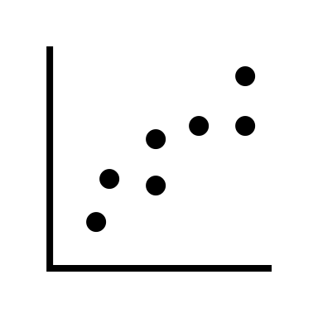

Who Am I?
Dr.

Slide 5



Who Am I?
Dr.

Slide 6
Who Are You?
Form groups of 3
Introduce yourselves (name, pronouns)
Share:
A highlight of your summer break
Find 1 thing that your entire group has in common (favorite color? hometown? left-handed? Be creative!)
After about 5 minutes we will go around, introduce ourselves, and share what each group has in common

Slide 7
Who Are You?
Form new groups of 3 (move around!)
Introduce yourselves (name, pronouns)
Share:
Would you rather live in an estate that can have anything you want but you can never leave OR live in a camper van and have to move every day?
After about 5 minutes we will go around, introduce ourselves, and share our would you rather answers

Slide 8
Who Are You?
Form new new groups of 3 (move around!)
Introduce yourselves (name, pronouns)
Share:
Would you rather have the ability to teleport (only yourself, no items) OR have instant deliveries?
After about 5 minutes we will go around, introduce ourselves, and share our would you rather answers

Slide 9
Name tags!

Slide 10
About this course
Communicating with data

Slide 11


About this course
Communicating with data

Slide 12
About this course
What are the strengths of each wrt data and communication?
Communicating with data

Slide 13


About this course
What are the strengths of each wrt data and communication?
Communicating with data

Slide 14
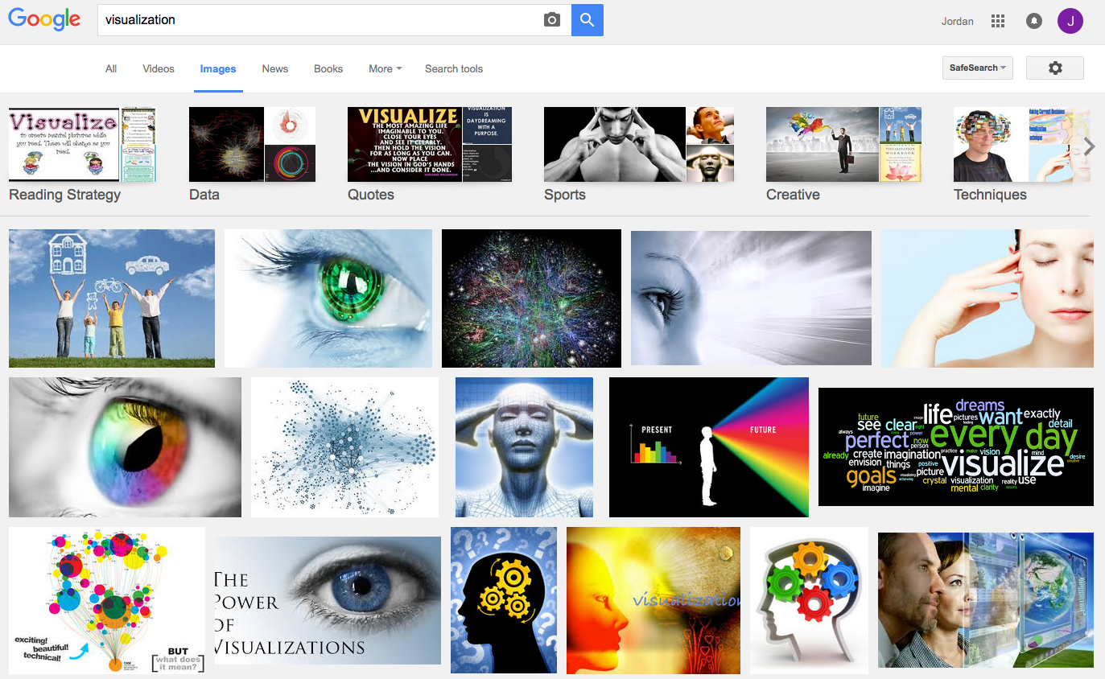
What is visualization?

Slide 15
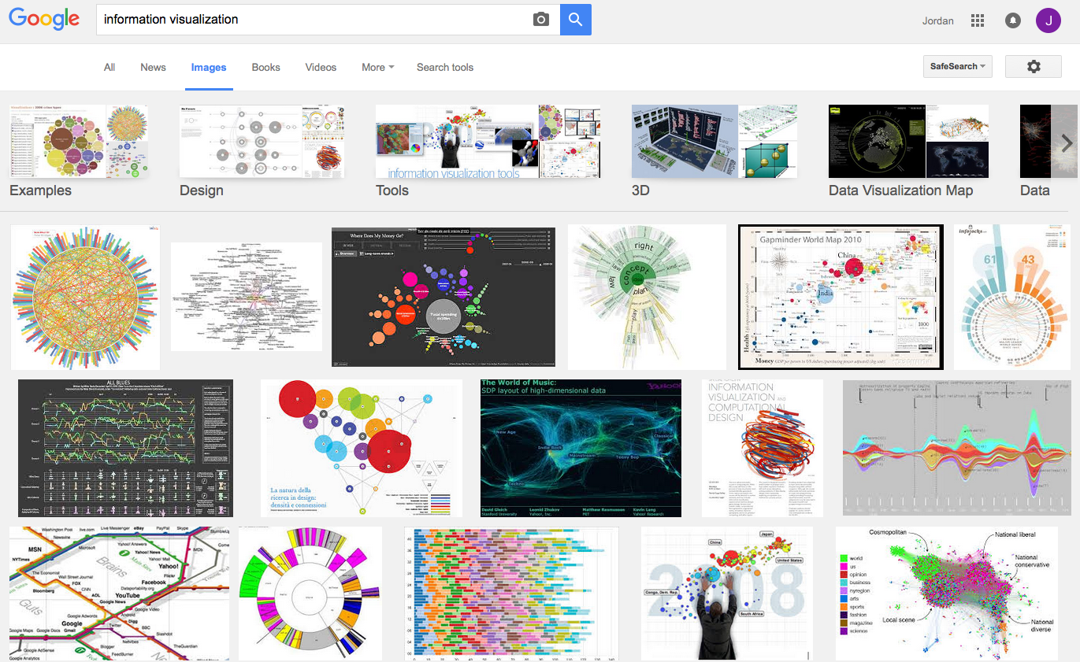
What is visualization?

Slide 16
Perhaps a more helpful question:
What are some ways
a “visualization” can be useful?

Slide 17
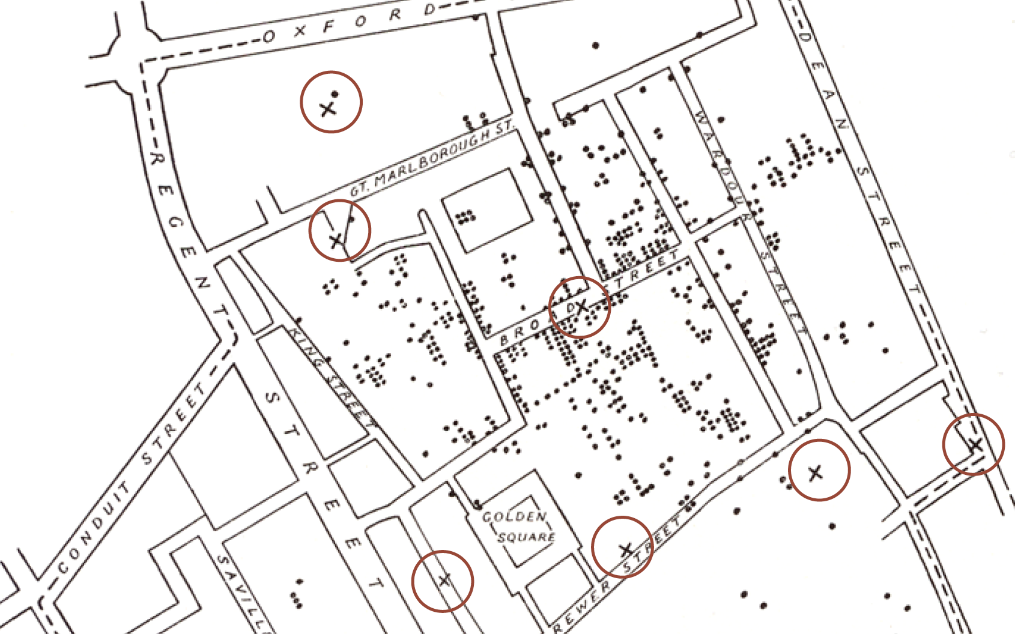
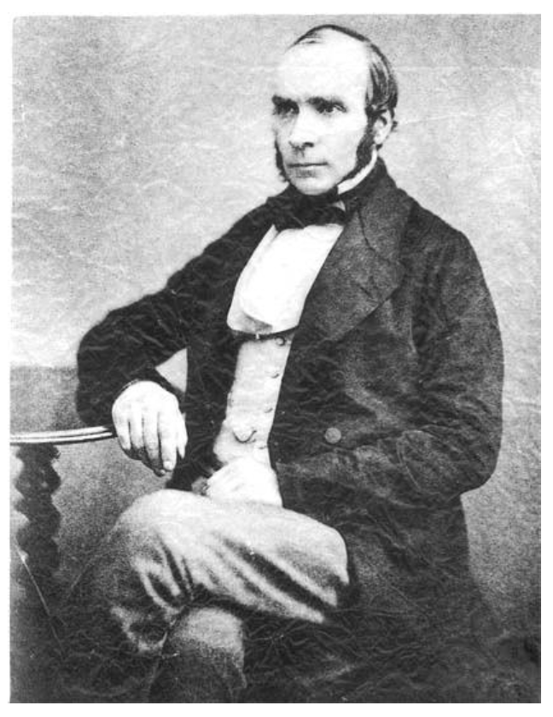
Does it help you spot trends?
In 1854, cholera broke out in London
127 people near Broad St. died within 3 days
616 people died within 30 days
Initial explanation:
“Miasma in the atmosphere”
Dr. John Snow was the first to link the outbreak to contaminated water
How did he do it?
Talked to local residents
Identified a water pump as a likely source
Used maps to illustrate his theory
Convinced authorities to disable the pump
More info here: http://en.wikipedia.org/wiki/1854_Broad_Street_cholera_outbreak

Slide 18
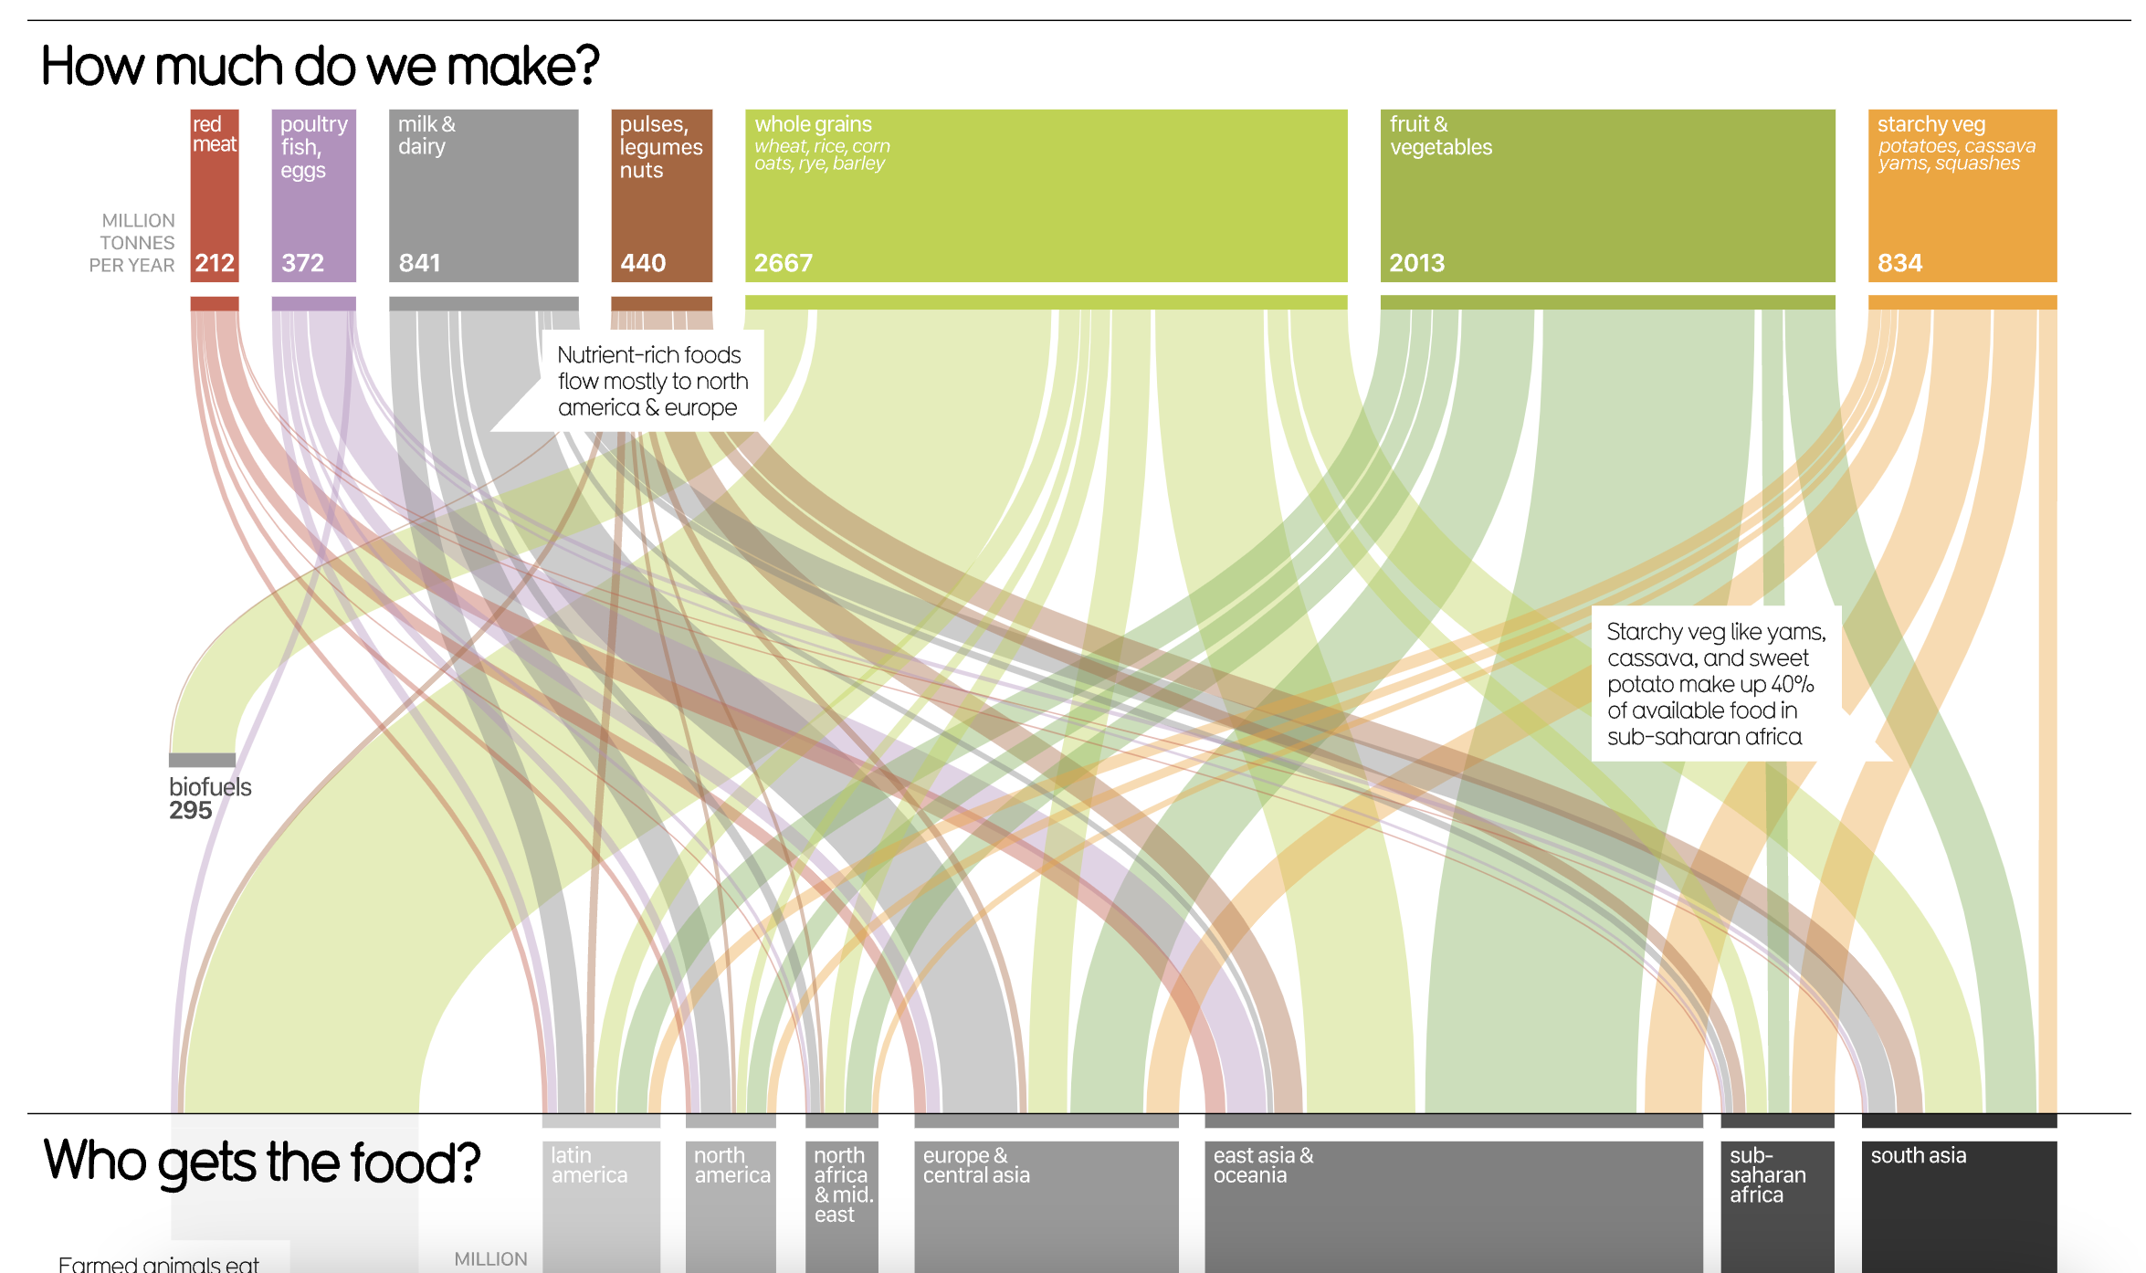
Does it help you explore?
https://informationisbeautiful.net/visualizations/global-food-supply-where-does-all-the-worlds-food-go/

Slide 19

Does it tell a story?
Hans Rosling’s 200 Countries, 200 Years, 4 Minutes – The Joy of Stats – BBC Four
https://www.youtube.com/watch?v=jbkSRLYSojo

Slide 20
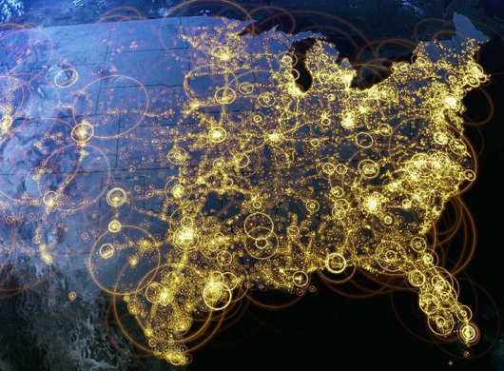
Visualization (def.)
Visual representations of data that reinforce human cognition
Notes:
Image from StackOverflow: http://i.stack.imgur.com/hbO8v.jpg

Slide 21

Wait… what is “data”?

Slide 22

Data: a definition
Data is a set of variables that capture various aspects of the world:
Tuition rates,
enrollment numbers,
public vs. private, etc.

Slide 23

Data: a definition
A dataset also contains a set of observations (also called records) over these variables. For example:
tuition = $46,288,
enrollment = 2,563,
private, etc.

Slide 24
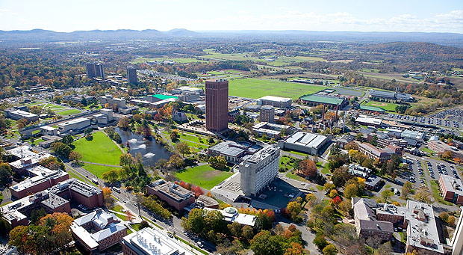

A dataset also contains a set of observations (also called records) over these variables. For example:
Data: a definition
tuition = $16,115,
enrollment = 28,635,
public, etc.

Slide 25
One way to think about this:
VARIABLES
 | Tuition | Enrollment | Public vs. Private | …
Smith College | $46,288 | 2,563 | private
UMass Amherst | $16,115 | 28,635 | public
Hampshire College | $48,065 | 1,400 | private
Mount Holyoke College | $43,886 | 2,189 | private
Amherst College | $50,562 | 1,792 | private
⋮
OBSERVATIONS

Slide 26
Another way to think about this
class school_obs:
def __init__(tuition, enrollment,
pub_or_priv):
self.tuition = tuition
self.enrollment = enrollment
self.pub_or_priv = pub_or_priv
smith = school_obs(46288, 2563, “private”)
umass = school_obs(16115, 28635, “public”)
VARIABLES
OBSERVATIONS

Slide 27

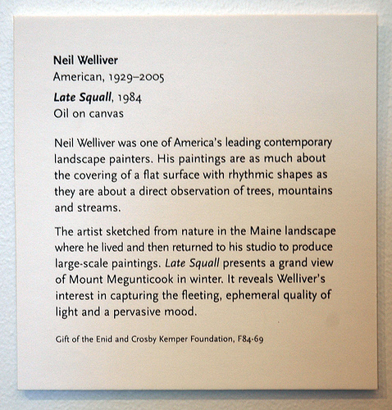
Yet another way to think about this
Information about the artist:
Name, place/date of birth,
date of death (if deceased)
Information about the piece:
Title, date, medium
Information about the donation:
Name of donor, reference number
Curated description and
relevant contextual information
Kinds of information = variables
Actual text on the placard = observations

Slide 28
Data: a definition
Each variable may be either independent or dependent:
An independent variable is not controlled or affected by another variable (e.g., time in a time-series dataset)
A dependent variable is affected by a variation in one or more associated independent variables (e.g., temperature in a region)

Slide 29
Basic data types
Nominal
Ordinal
Scale / Quantitative
Ratio
Interval
An unordered set {…}
of non-numeric values
For example:
Categorical (finite) data
{apple, orange, pear}
{red, green, blue}
Arbitrary (infinite) data
{“12 Main St. Boston MA”, “45 Wall St. New York NY”, …}
{“John Smith”, “Jane Doe”, …}

Slide 30
Basic data types
Nominal
Ordinal
Scale / Quantitative
Ratio
Interval
An ordered set <…>
(also known as a tuple)
For example:
Numeric: <2, 4, 6, 8>
Binary: <0, 1>
Non-numeric:
<G, PG, PG-13, R>

Slide 31
Nominal
Ordinal
Scale / Quantitative
Ratio
Interval
A numeric range […]
Ratios
Distance from “absolute zero”
Can be compared mathematically using division
For example: height, weight
Intervals
Ordered numeric elements that can be mathematically manipulated, but cannot be compared as ratios
E.g.: date, current time
Basic data types

Slide 32
Converting between basic data types
Q → O [0, 100] → <F, D, C, B, A>
O → N <F, D, C, B, A> → {C, B, F, D, A}
N → O (??)
{John, Mike, Bob} → <Bob, John, Mike>
{red, green, blue} → <blue, green, red>
O → Q (??)
Hashing?
Bob + John = ??
Discussion: what do you notice?
Readings in Information Visualization: Using Vision To Think. Card, Mackinglay, Schneiderman, 1999

Slide 33
Basic operations
Nominal (N)
Equality: = and ≠
Frequency: how often does x appear?
Ordinal (O)
Relation to other points: >, <, ≥, ≤
Distribution: inference on relative frequency
Quantitative (Q)
Other mathematical operations: (+, -, *, /, etc.)
Descriptive statistics: average, standard deviation, etc.

Slide 34
Why is this important?
Data have dimensions
Visualizations have dimensions, too
To build visualizations, we need to map data dimensions to visual dimensions

Slide 35
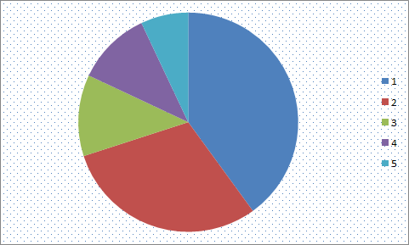
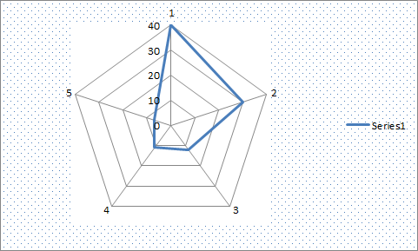
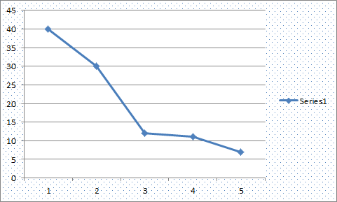
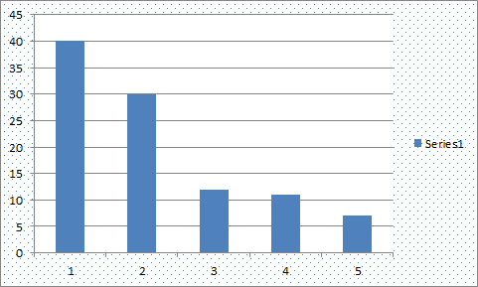
Key question for this course
Which data dimension should be mapped
to which visual dimension?

Slide 36
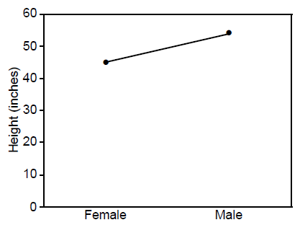
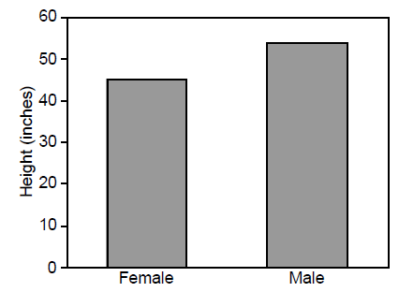
Answer: it depends
Average Height for Youth Sports Participants
Gymnastics Basketball
Gymnastics Basketball

Slide 37
What we’ll cover in this class
Visualization Fundamentals (next class)
Perception
Design Principles
Color Theory
Dealing with Multiple Variables
Text Data
Storytelling with Data
Data-Driven Journalism
Animation and Movement
Interactive Visualization
Visualization Fundamentals (next class)
Perception
Design Principles
Color Theory
Dealing with Multiple Variables
Text Data
Storytelling with Data
Data-Driven Journalism
Animation and Movement
Interactive Visualization

Slide 38
General information
Course website:
https://amosca01.github.io/SDS-CS109/

Slide 39



Structure of this course
Disclaimer:
this class is an experiment in constructionism
(the idea that people learn most effectively
when they’re building personally-meaningful things)
Our job as instructors:
Notes:
Expose you to some foundational principles and available tools
Ask questions that build your intuitions about identifying problems where visualization techniques can help
Most important: help you find opportunities to solve real problems in areas YOU care about (and hopefully learn some cool stuff about visualization along the way…)

Slide 40

Preparing for labs
Our labs will be run using Tableau, a drag-and-drop visualization tool suite
Tableau for Teaching has donated license keys (good for one year) for everyone enrolled in this course
Instructions for getting a license will be posted to shortly; please install before next class!
Need help? Ping me, or come to office hours

Slide 41
Course project
Goals:
Learn how to break big, unwieldy questions down into clear, manageable problems
Figure out if/how the techniques we cover in class apply to your specific problems
Use visualization to address them
Several (graded) milestones along the way
Demos and discussion on the final day of class
gain real experience | solve real problems
build real relationships

Slide 42
What you’ll get
By the end of this course, you will:
Know how to use visualization to communicate ideas
Know the foundational methods and tools available
Be familiar with ongoing research in visualization
Have (marketable!) experience developing useful visualizations to solve real problems

Slide 43
What I expect from you
You like challenging problems, and you’re excited about “figuring stuff out”
You’re willing to get comfortable asking questions
You’re interested in the perspectives of people with very different backgrounds from your own
You turn things in on time, show up to class, or let me know in advance*

Slide 44
What you can expect from me
I’m flexible w.r.t. the topics we cover:
This course is a collaboration
If there’s something you want to learn that’s not on the agenda, speak up!
If I’m doing something that doesn’t work for you (Font too small on presentations? Speaking too quickly? Using a marker or color you can’t see?), please let me know!
I’m here to help you succeed, and I believe you all have the ability to succeed

Slide 45
Before next class
Email Ab if you don’t have a computer that will support Tableau

Slide 46
Questions?

